Slide 1

Final Review Report
User Sleep and Charging Pattern Detection with On-Device Learning
Team
College Professor(s): Dr. S. Vairamuthu and Dr. Anil Kumar K.
Students:
Oindrilla Bose
Nishant Pandey
Porwal Kakshak Pravin
Department: Computer Science and Engineering
Date: 4th August 2020

Slide 2


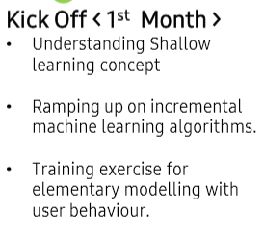
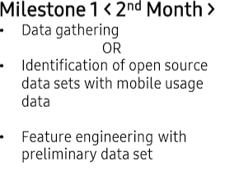

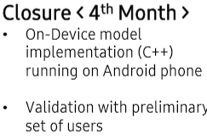
Sleep Pattern Detection
ML | User Sleep & Charging Pattern detection with On-Device Learning
Mobile devices have become an integral part of life for people.
While they are awake, a smartphone is heavily used and relied up on for entertainment, social media, learning, gaming etc.
And during sleep time, a device will kept idle and doing operations like charging or update.
Problem to Solve: Learning about time windows in a day, wherein a smartphone will be heavily used or not used at all, will enable scheduling of book keeping , system optimization operations efficiently.
Expectations
On-Device learning model development for learning device user’s sleep pattern
This learning should happen within a device as pre-trained options tends to be not accurate. Regardless of usage of pre-trained or not, the model should learn and adapt for sleep pattern of user
Develop library exposing API for retrieving 24-slices representing time-windows from a given point of time, each having confidence of user’s sleep.
No dependencies or usage at all of wearable devices in terms of input/ modelling/inference.
Final model should be developed on C++and should run on smartphone.
Training/ Pre-requisites
Good knowledge into statistical and shallow learning
methods
Incremental Machine Learning algorithms
Student Learning
Machine learning Concepts.
Usage stats manager.
Android App development.
Iterative approach.
3
Members
Notes:
-

Slide 3
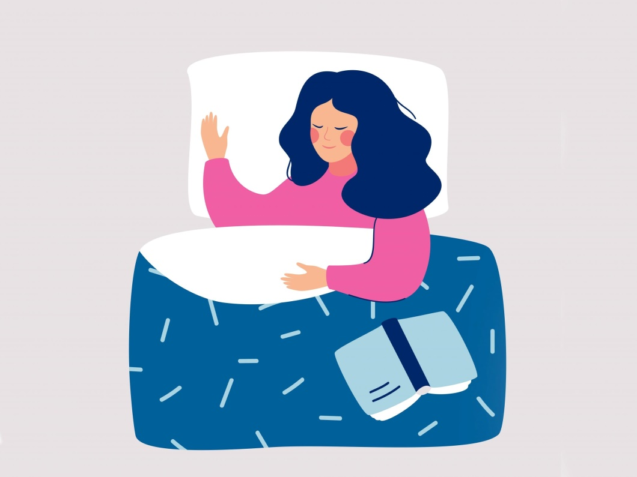
Proposed Approach / Solution
Initial Approach Proposed
Through this project, our main motive is to design an intelligent method through which the device (a mobile in this case) can predict on its own the user sleep pattern. When would the user sleep or just stop using his phone and hence from these idle hours, one could predict the most suitable time for charging the device. So the main concern of this project was first to get hold of data acquired, from different users, that would help us figure out the exact time slabs in which the users did not use their phone.

Slide 4
Literature Survey Done for Problem Understanding
Journal 1:
Scalable Passive Sleep Monitoring Using Mobile Phones: Opportunities and Obstacles
By Yu Sun Bin, Yan Ma, and Blaine Price, 2017 April
This paper mainly focussed on finding features which would help to determine if the user is asleep or not from the sensor data present in the phone. They mainly used features like activity recognition (API) information, light sensors, sound sensors, state of the screen, battery percentage, GPS location, Wifi connections and the MAC address of the access points, contact details and call logs, time of the day. They collected data from users through a trusted app which hashed the private details of the user. From the data they analysed and trained the classifier algorithms like decision tree, random forest using a 10 minute long window for each user. They then tried to classify the 10 minute long window to be of that from sleep or awake state. When they trained on a user’s data and validated it using the data of other users, the accuracy was found to be 89%.
Limitations:
1. Self reported time of sleep wasn’t accurate
2. The parameters of the classifier were adjusted under the assumption that going to sleep and waking up occur only once in 24 h. This was violated for some users.
3. The data could not show if anyone had any sleeping disorder.

Slide 5
Literature Survey
Journal 2:
Smartphones as Sleep Duration Sensors: Validation of the iSenseSleep Algorithm
Matteo Ciman, MSc, PhD; Katarzyna Wac, BSc, MSc, PhD 2019 May
In this paper, they used the fact that Smartphones are becoming more assimilated into our everyday life, being the last thing used before going to sleep and the first one after waking up. This strong correlation between our lifestyle choices and smartphone interaction patterns enabled them to use it as sensors for sleep duration assessment to understand individuals’ lifestyle and sleep patterns. The objective of this study was to estimate sleep duration based on the analysis of the users’ ON-OFF interaction with their smartphone alone using the iSenseSleep algorithm.
Methods:
They used smartwatch sleep assessment data as the ground truth. Results were acquired with 14 different subjects collecting smartwatch and smartphone interaction data for up to 6 months each.
Results:
Results showed that based on the smartphone ON-OFF patterns, individual’s sleep duration can be estimated with an average error of 7% enabling an estimate of sleep start and wake-up times as well as sleep deprivation patterns.

Slide 6
Few Online Resources
Resource 1:
Responding to user activity with the Activity Recognition API
https://www.androidauthority.com/using-the-activity-recognition-api-829339/#:~:text=The%20Activity%20Recognition%20API%20is%20an%20interface%20that%20periodically%20wakes,using%20powerful%20machine%20learning%20models
The Activity Recognition API is an interface that periodically wakes the device, reads bursts of data from the device’s sensors, and then analyzes this data using powerful machine learning models
Resource 2:
How to calculate sound frequency in android
https://stackoverflow.com/questions/12721254/how-to-calculate-sound-frequency-in-android
Resource 3:
How to use getState method in android.view.Display
https://www.codota.com/code/java/methods/android.view.Display/getState
This API tells us if the screen of the android phone is in an ‘on’ or ‘off’.

Slide 7
Few Online Resources
Resource 4:
Android Location API to track your current location
https://www.journaldev.com/13325/android-location-api-tracking-gps
This API uses the LocationListener method to predict the gps location of an individual. The coordinates provided tell us if the user is at home if it is 0.
Resource 5:
Measure Light intensity in android | Light sensor in android
http://androidapplink.blogspot.com/2015/06/measure-light-intensity-in-android.html
The light intensity of the android device can be found out using the light sensor value in lux.
Resource 6:
Java Examples - Write Data into Excel Sheet
https://www.tutorialspoint.com/javaexamples/write_data_into_excel_sheet.htm
This resource tells us how to collect the data from android device and put it in an excel sheet.

Slide 8
Few Online Resources
Resource 7:
Sensor Types
https://source.android.com/devices/sensors/sensor-types
Resource 8:
Accelerometer Sensor
https://www.sciencedirect.com/topics/engineering/accelerometer-sensor
Accelerometer sensors are fixed to get acceleration along the X,Y and Z axes. They record the GPS coordinates and are helpful to detect the motion of a person.
Resource 9:
Exploring Android’s Proximity Sensor
https://blog.k.io/atech/exploring-androids-proximity-sensor
In Android, the proximity sensor is primarily used to detect when the user’s face is close to the screen. This is how the phone screen seems to know to switch off when you hold it up to your ear during phone calls, preventing any errant button presses

Slide 9
Proposed Approach / Solution
Steps Followed by Us
Step 1
Firstly we did a detailed research on the field of sensors that are inbuilt in the android phones. We looked up online resources that would help us in the same.
Step 2
We searched for few research papers that would help us get started with the data retrieval part.
Step 3
We noted down few important sensors that might tell us what are the parameters that can predict if a person is using the phone or is in the idle state.
Step 4
We circulated a Google form among 187 participants in which we asked few questions regarding their phone usage pattern and what they thought might be the important features about their phone which could help us to analyse the problem statement better.

Slide 10
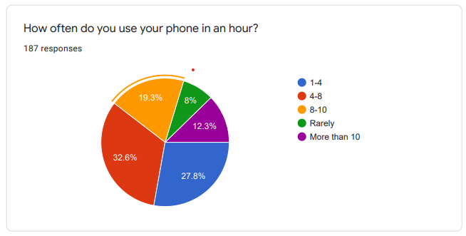
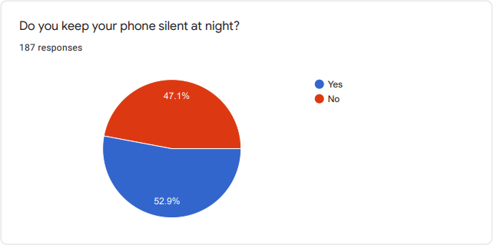
Proposed Approach / Solution
Steps Followed by Us
Analysis of the response from Google form

Slide 11
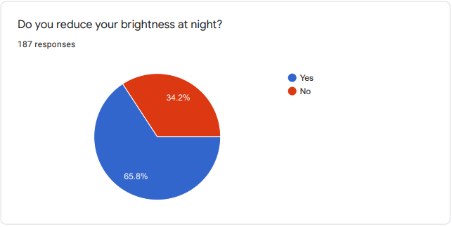
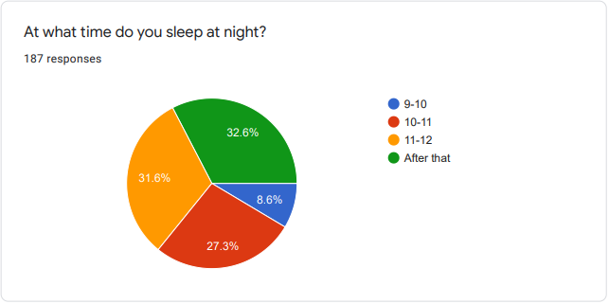
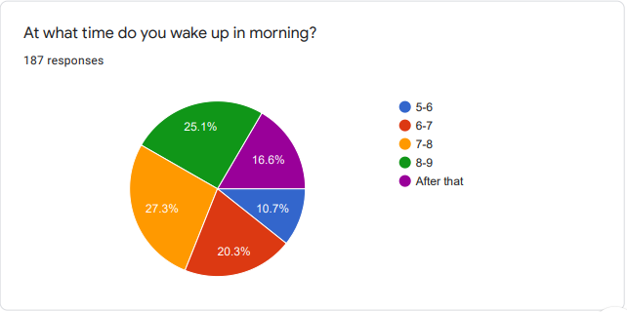
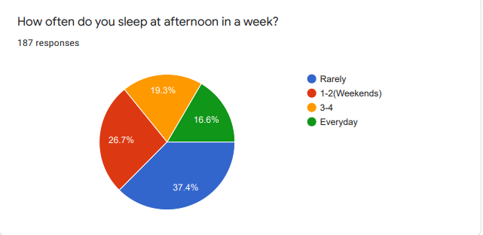
Proposed Approach / Solution

Slide 12
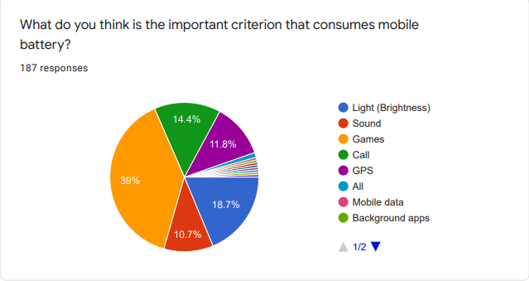
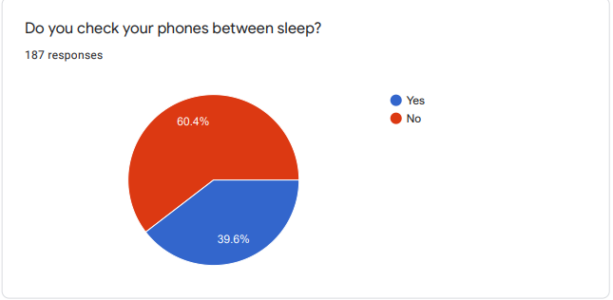
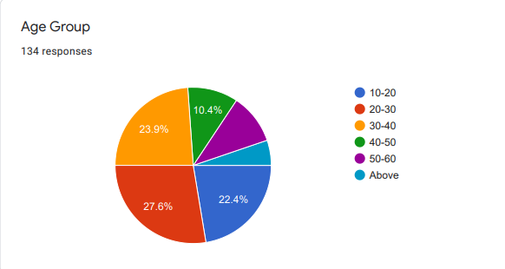
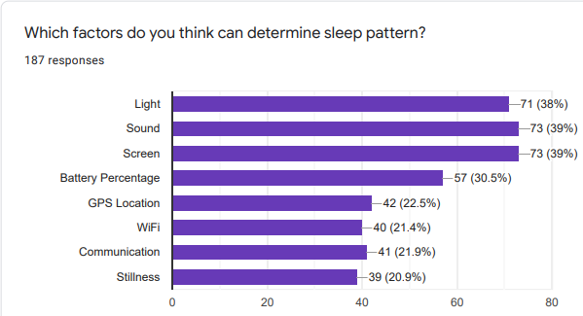
Proposed Approach / Solution

Slide 13
Data Acquisition
We collected the data of 4 individuals of ages 21,45,48,30. We asked them also to tell us the exact times of the day when they went to sleep. All the 4 users used Samsung models as their phones. Using one of the developer tools, we extracted the data from their phone. The inbuilt sensor readings helped us to proceed with the experiment. We monitored the data of these 4 individuals for a period of 7 days.
Dataset
The data collected by us contained the information from 12 different sensors of the smartphone as listed in the table. Two more sensors (still alive and gyroscope) were ignored in data set as they did not include useful information for our purpose.
So, the data collected included the values of each sensor accompanying by the corresponding timestamp. Every sampling period took 2 minutes and the values of the sensors were stored every second, during the sampling period and a mean value of the sensors were recorded.

Slide 14
Sensors Tracked
Sensor | Description
Accelerometer | Acceleration rate
App | Currently running app
Audio level | Audio volume level
Charging | Charging state of device
Gyroscope | Devices rate of rotation
Light sensor | Ambient light level
Proximity | Proximity of object relative to screen of device
Ringtone_volume | Ringtone volume level
Screen_on_off | State of screen
Wifi_ssid | Current wifi in use
Airplane_mode | Mode of the device
Stillalive | General state of device

Slide 15
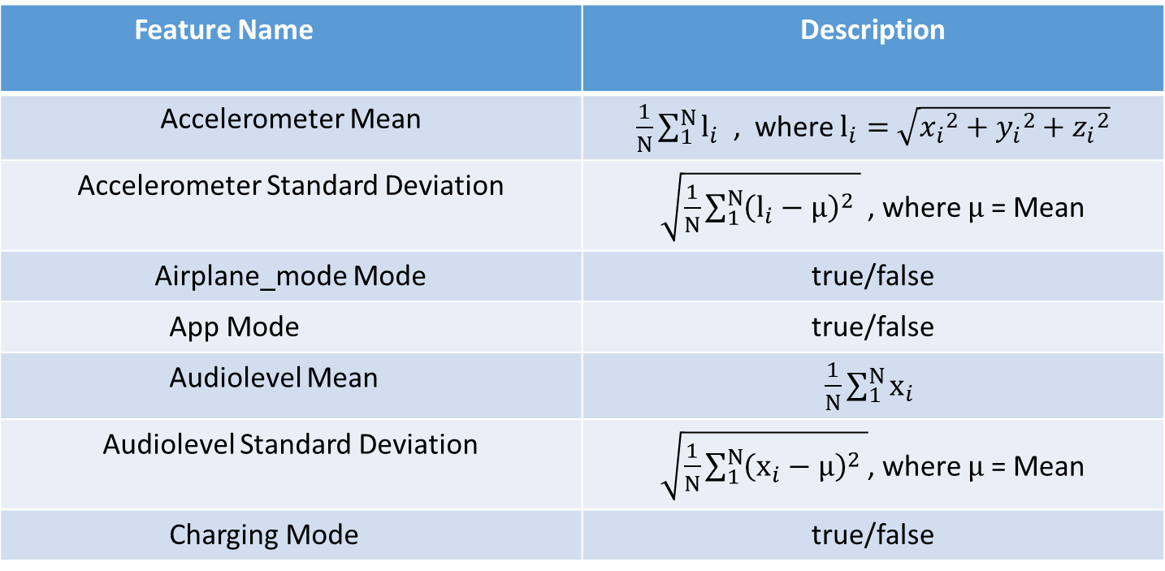
Sleep Classification
Feature Extraction
From the different sensors the features that were extracted are as follows
Feature Name | Description
Accelerometer Mean | $\frac{1}{N}\sum_{1}^{N}{l_{i}}$ , where $l_{i}=$ $\sqrt{{x_{i}}^{2}+{y_{i}}^{2}+{ z_{i}}^{2}}$
Accelerometer Standard Deviation | $\sqrt{\frac{1}{N}\sum_{1}^{N}{{\left(l_{i}−µ\right)}^{2} }}$ , where $µ$ = Mean
Airplane_mode Mode | true/false
App Mode | true/false
Audiolevel Mean | $\frac{1}{N}\sum_{1}^{N}{x_{i}}$
Audiolevel Standard Deviation | $\sqrt{\frac{1}{N}\sum_{1}^{N}{{\left(x_{i}−µ\right)}^{2} }}$, where $µ$ = Mean
Charging Mode | true/false
…… ( i )

Slide 16
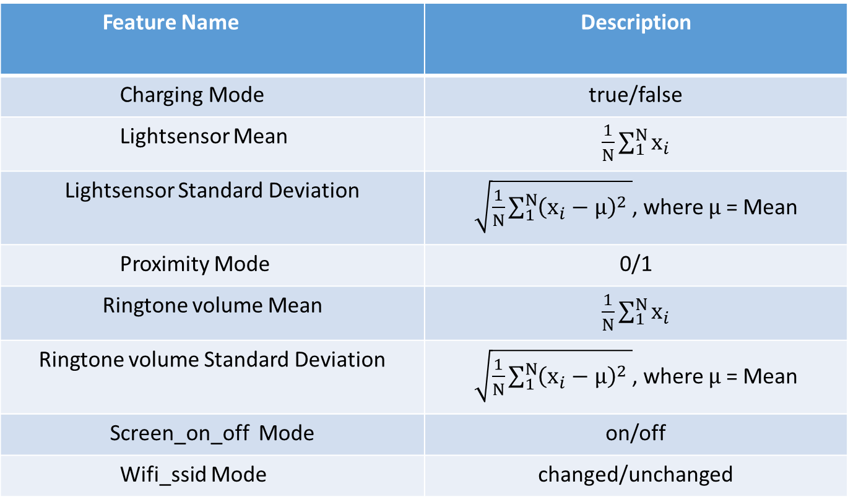
Sleep Classification
Feature Name | Description
Charging Mode | true/false
Lightsensor Mean | $\frac{1}{N}\sum_{1}^{N}{x_{i}}$
Lightsensor Standard Deviation | $\sqrt{\frac{1}{N}\sum_{1}^{N}{{\left(x_{i}−µ\right)}^{2} }}$, where $µ$ = Mean
Proximity Mode | 0/1
Ringtone volume Mean | $\frac{1}{N}\sum_{1}^{N}{x_{i}}$
Ringtone volume Standard Deviation | $\sqrt{\frac{1}{N}\sum_{1}^{N}{{\left(x_{i}−µ\right)}^{2} }}$, where $µ$ = Mean
Screen_on_off Mode | on/off
Wifi_ssid Mode | changed/unchanged
…… ( ii )

Slide 17
Filtering of Data
In case it was seen that the any of the features extracted did not have any value, then ‘NaN’ was placed in its place as data pre-processing technique. Furthermore, we checked the CSV files to discover if there are any useless features. For example in this step the feature Wifi-ssid mode was ignored, since it contained no important information. So, in this part the six following features were eliminated:
Airplane_mode Mode
App Mode
Charging Mode
Ringtone_volume Mean
Ringtone_volume Standard Deviation
Wifi_ssid Mode

Slide 18
Final Set of Features
From this step onwards, we continued the classification with the eight remaining features:
1. Accelerometer Mean
2. Accelerometer Standard Deviation
3. Audiolevel Mean
4. Audiolevel Standard Deviation
5. Lightsensor Mean
6. Lightsensor Standard Deviation
7. Proximity Mode
8. Screen_on_off Mode

Slide 19
Model Development
In this step, we have tried to recognize and understand the relation between the features and physical state of the user, through appropriate classifier. The aim was to eliminate the irrelevant features from the features list in order to get a better performance and finally find the minimum number of features, which deliver the most important information.
Choosing the Classifier
For building our user-independent model, we decided to use three kinds of classifiers. As Naive Bayes, Random forest, SVM were the most commonly used classification algorithms for sleep classification, we chose them as our classifiers. We compared the performance of the classifiers.
To evaluate the classifier performance, we modified the k-cross-validation. In our approach, each iteration included the dataset of one user (considered as the test set) and the rest of data considered as the training set.
We did this as we wanted to prevent a random division of the data set into k disjoint sets of equal size.

Slide 20
Comparison of the Classifiers
Classifier | Precision | Recall | F-Measure
Naïve Bayes | 0.88 | 0.90 | 0.88
Random Forest | 0.75 | 0.69 | 0.71
SVM | 0.90 | 0.91 | 0.92
The best performance was seen to be that of SVM hence from then onwards we used only SVM for analysis.

Slide 21
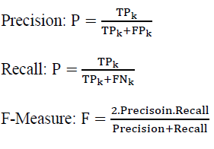
Feature Analysis
The next goal was to improve the results of the evaluation and possibly to increase the performance by removing some features. We tested using only a 2 minute long window and a combination of features.
Evaluation of the features
In a binary classification, as our case, there are four different possibilities for a prediction. The true positives (TP) and true negatives (TN) are correct classifications, which are desirable. A false positive (FP) is when the object is incorrectly mapped to the class “yes” (or positive) when it does not belong to it actually (negative). A false negative (FN) is when the object is incorrectly mapped to the class “no” when it is actually positive.
We tried to evaluate the prediction using the Precision, Recall and F-measure values.

Slide 22
Table of Comparison
Features | Precision | Recall | F-Measure
Accelerometer mean Audio level mean | 0.41 | 0.16 | 0.58
Accelerometer mean Light sensor mean | 0.76 | 0.81 | 0.89
Accelerometer mean Proximity | 0.37 | 0.01 | 0.54
Accelerometer mean Screen mode | 0.37 | 0.02 | 0.54
Audio level mean Light sensor mean | 0.98 | 0.89 | 0.96
Audio level mean Proximity | 0.96 | 0.86 | 0.97
Audio level mean Screen mode | 0.93 | 0.96 | 0.96
Light sensor mean Proximity | 0.92 | 0.91 | 0.90
Light sensor mean Screen mode | 0.90 | 0.84 | 0.88
Proximity Screen mode | 0.80 | 0.85 | 0.89
This table shows the comparison between 2 feature combinations for a 2 minute long window frame.
So for the double combination of features provided “Light sensor Mean & Proximity Mode”, “Audio Level Mean & Screen Mode” , “Light sensor Mean & Screen_on_off Mode” performed pretty well.

Slide 23
Features | Precision | Recall | F-Measure
Accelerometer mean Audio level mean Light sensor mean | 0.78 | 0.83 | 0.87
Accelerometer mean Audio level mean Proximity | 0.41 | 0.16 | 0.58
Accelerometer mean Audio level mean Screen mode | 0.42 | 0.18 | 0.58
Accelerometer mean Light sensor mean Proximity | 0.76 | 0.81 | 0.86
Accelerometer mean Light sensor mean Screen mode | 0.78 | 0.84 | 0.88
Accelerometer mean Proximity Screen mode | 0.37 | 0.01 | 0.54
Audio level mean Light sensor mean Proximity | 0.96 | 0.91 | 0.93
Audio level mean Light sensor mean Screen mode | 0.93 | 0.96 | 0.91
Audio level mean Proximity Screen mode | 0.93 | 0.91 | 0.88
Light sensor mean Proximity Screen mode | 0.89 | 0.94 | 0.89
The best trio-combination of the features is “Audio level mean & Light sensor Mean & Proximity Mode”.

Slide 24
Features | Precision | Recall | F-Measure
Accelerometer mean Audio level mean Light sensor mean Proximity mode | 0.76 | 0.81 | 0.89
Accelerometer mean Audio level mean Light sensor mean Screen mode | 0.76 | 0.81 | 0.89
Accelerometer mean Audio level mean Proximity Screen mode | 0.41 | 0.16 | 0.58
Accelerometer mean Light sensor mean Proximity Screen mode | 0.78 | 0.84 | 0.91
Audio level mean Light sensor mean Proximity mode Screen mode | 0.96 | 0.88 | 0.91
Results showed, we achieved the best results for combinations of four features, when we used “Audio level mean, Lightsensor Mean, Proximity Mode, Screen_on_off Mode”.

Slide 25
Limitations
Attempts were made to develop an accurate sleep tracking model using three different classifiers and with different sampling periods and feature combinations. This was achieved as well, but from the first step we had to take some limitations into account.
First of all, in our user study, we had 4 participants available only. We carried out our study for just around a week. It could have been possible to get a better data set, if we could have more participants from a wide range of age groups and professional field, and over a longer period of time.
Applying more classifier algorithms might have further increased the accuracy of the result.

Slide 26
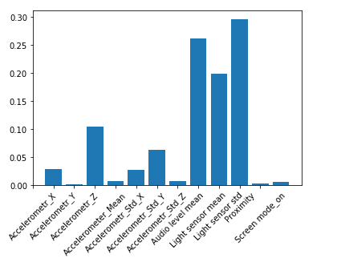

Conclusion
When we did a feature analysis then we came up with the following graph. Features like audio level readings, light sensor, proximity and screen mode readings together proved to helpful in the analysis of the user sleep pattern.
The final result produced using SVM

Slide 27
Code Details
Google Drive Link
https://drive.google.com/drive/folders/1hAGGNUHO93NfICVwqp5-0mvpsbhvwi3P?usp=sharing
Parameter | Details
Model/Algorithm Details | Naïve Bayes, Random Forest, SVM
Details of Dataset collected | In total 4 datasets Fresh Data.csv- of the first user User 1.csv- of the second user User 2.csv- of the third user User 3.csv- of the fourth user
List of reports uploaded | Battery Usage and Sleep Pattern detection: graphs from the google form Fresh_data.csv User 1.csv User 2.csv User 3.csv Google form responses Literature survey papers Naïve Bayes.html Random forest.html SVM.ipy Observations Sleep RnD ppt

Slide 28
Thank you

